Slide 1
REALTIME ACCENT TRANSLATION
PIP2001 Capstone Project
VIVA-VOCE
Batch Number: Cse-43
Roll Number | Student Name
20211CSE0542 20211CSE0154 20211CSE0077 20211CSE0159 20211CSE0149 | Aditi Gupta V A Mayavathi Veerajinnappa Gari Hemavathi Ballani Vignesh K.Gnanendra Verma
Under the Supervision of,
Dr. Galiveeti Poornima
School of Computer Science and Engineering
Presidency University
Name of the Program:. B.Tech
Name of the HoD: Dr. Asif Mohammed H B
Name of the Program Project Coordinator: Mr. Amarnath J L, Dr. Jayanthi Kamalasekaran
Name of the School Project Coordinators: Dr. Sampath A K / Dr. Abdul Khadar A / Mr. Md Ziaur Rahman

Slide 2
Introduction
Real-Time Accent Translation refers to the process of converting spoken language from one accent to another instantly, enabling effective communication across diverse linguistic and cultural boundaries. Accents, which represent variations in pronunciation influenced by region, culture, or native language, can sometimes hinder mutual understanding. This technology aims to eliminate such barriers by standardizing or adapting accents in real time. This can be done unidirectionally or bidirectionally.
In a globalized world, effective communication is vital. People from different regions often face challenges in understanding each other's speech due to unfamiliar accents. For example, a person with an Indian accent might find it challenging to comprehend a strong British or American accent, and vice versa. Real-time accent translation addresses these issues by normalizing pronunciation differences, enhancing clarity, and fostering inclusivity.

Slide 3
Literature Review
A literature survey on real-time accent translation includes the study of research and developments in speech recognition, accent adaptation, natural language processing, and speech synthesis technologies. This section gives emphasis on foundational works, state-of-the-art methodologies, and challenges and solutions proposed in the field.
Speech Recognition and Accent Identification:-Speech recognition is the core technology for real-time accent translation. Various research studies have focused on its accuracy for different accents: Hinton et al. (2012) introduced deep neural networks for acoustic modeling that greatly improved the accuracy of speech recognition, especially for non-native speakers.

Slide 4
Turing et al. (2019) addressed accent variability in speech recognition systems and proposed transfer learning to adapt models for underrepresented accents. Chen et al. (2020) investigated the use of attention-based mechanisms, such as transformers, to enhance the ability of speech recognition systems to handle regional phonetic variations.
Accent Adaptation Techniques:-Accent adaptation has been an important research area to make speech processing systems more inclusive: Shannon et al. (2017) presented speaker adaptation techniques with GMMs for better system performance for unseen accents during training.

Slide 5
Research Gaps Identified
General Research Gaps
Low-Resource Accents: Most accents, especially regional and less frequently spoken ones, do not have enough labeled datasets to train robust models.
Contextual Understanding: Translating accents often requires contextual understanding because accents may contain specific idiomatic expressions or phonetic variations that can change the meaning.
Real-Time Processing: Low latency in real-time scenarios with high-quality translation is computationally expensive, especially on edge devices with limited resources.

Slide 6
Evaluation Metrics: The existing evaluation metrics for accent translation might not capture the perceptual quality or user satisfaction in full.
Code-Switching: Many speakers mix languages or accents in real-time conversations. Handling these dynamically is a challenging and underexplored area.
Noise Robustness: Handling noisy environments (e.g., background conversations, traffic) effectively without compromising translation quality.
Ethical Considerations: Accent misrepresentation or stereotype reinforcement due to biased data can lead to societal and ethical issues.

Slide 7
Proposed methodology
The development of a Real-Time Accent Translation system is a systematic approach to integrating speech recognition, accent transformation, and speech synthesis using advanced AI technologies. Below is the proposed methodology:
Data Collection and Preprocessing
Objective: Collect diverse audio datasets for training machine learning models.
Dataset Collection: Gather speech samples from speakers with different accents for a target language, say, Indian, American, and British accents for the English language. Some good public datasets include Librispeech, VoxForge, or Mozilla Common Voice.

Slide 8
Preprocessing
Normalize audio data to standard format (sampling rate, file type).
Remove background noise using audio processing libraries.
Label data with accent tags to train accent classification models.
Speech Recognition
Goal: Transcription of spoken words to text for further processing.
Implement Automatic Speech Recognition (ASR) using pre-trained models like Google's Speech-to-Text API, Whisper, or Kaldi.
Train a custom ASR model if required using labeled audio data.
Fine-tune for accent-specific variations to improve accuracy

Slide 9
Accent Detection and Classification
Task: Identify the accent of the speaker to determine how to transform it.
Utilize machine learning algorithms (for example, Support Vector Machines, CNNs) or advanced neural architectures such as transformers.
Train the model based on phonetic features and acoustic patterns specific to each accent
Testing: Use accuracy, precision, and recall so as to have reliable classification.
Accent Transformation
Goal: Take the identified accent and convert it into the target or neutral accent.
Phonetic Mapping
Identify the source-to-target accent differences in the pronunciation, intonation, and stress.

Slide 10
Map source accent phonemes to its target accent equivalent
Deep Learning Models:
Apply Seq2Seq models, VAEs (Variational Autoencoders) or GANs (Generative Adversarial Networks) to transform voice.
Train on paired data with the same speech but different accents.
Deployment and Maintenance
Develop a user-friendly interface, such as a mobile app or web-based platform.
Continuously update the system with new accents and optimize based on user feedback.

Slide 11
Objectives
The prime focus of real-time accent translation is to remove the hindrance in communication due to diverse accents in spoken words and provide clear and fluent verbal communication between individuals or groups with different linguistic and cultural backgrounds. This includes forming an efficient system that will recognize, interpret, and modify the spoken language with the desired or neutral accent with all the original intonations and flavor intact.
Major Goals:-
Better Clarity in Communication: Make speech easier to understand by transforming regional or heavily accented pronunciations into neutral or preferred accents, allowing listeners to understand more easily.

Slide 12
Create Inclusivity:Ensure that people with different linguistic backgrounds can engage freely in dialogue without misunderstandings and that there is an inclusion in global settings.
Support Global Connectivity:Support international business, education, and customer service by offering tools to transform spoken content for multiple audiences, hence strengthening international collaboration.

Slide 13
System Design and Implementation
Real-Time Accent Translation is a complex system that needs to integrate several components, each of which performs specific tasks such as audio input processing, accent recognition, translation, and synthesis. Below is a detailed design and implementation overview.
System Design The system architecture consists of four main components:
1. Audio Input Module
Captures speech through a microphone or audio input device.

Slide 14
It ensures real-time streaming capabilities with minimal latency.
Preprocessing methods such as noise reduction and normalization enhance the quality of the input.
2. Accent Detection Module
Function: Identifies the accent of the speaker using acoustic and phonetic features of the audio input.
Implementation:
A pre-trained machine learning models, such as CNNs or RNNs, can be used, which were trained using different accent datasets.

Slide 15
Accent detection is done using MFCC.
Output: The classification of the accent label, say "Indian English", "British English".
3. Accent Translation Module
Function: Convert the input accent to the target accent with preservation of the linguistic meaning and intonation.
Implementation:
Sequences-to-sequences models; transformers; for example, T5 or BERT for text.

Slide 16
Phonetic patterns mapping from the source accent to the target accent
Context-aware speech alignment is used for good translation accuracy.
4. Speech Synthesis Module
Function: This module produces audio in the target accent while preserving the voice characteristics of the speaker.
Implementation:
TTS systems like Tacotron 2 or WaveNet are fine-tuned to produce accent-specific pronunciation.

Slide 17
Emotional tone and intonation are preserved.
Output: Real-time audio in the desired accent.
Implementation Steps
Step 1: Data Collection and Preprocessing
Dataset: Collect a diverse dataset of speech samples covering multiple accents, languages, and scenarios.
Preprocessing: Audio cleaning, segmentation, and feature extraction. Convert audio to text using automatic speech recognition (ASR) tools.

Slide 18
Step 2: Accent Recognition
Train a supervised learning model on the dataset with features like MFCCs, pitch, and energy contours.
Use transfer learning with pre-trained models to improve accuracy in recognizing subtle accent differences.
Step 3: Accent Mapping and Translation
Develop a phonetic mapping dictionary to link source and target accent sounds.
Implement sequence-to-sequence models with attention mechanisms to ensure accurate and context-aware mapping.

Slide 19
Step 4: Speech Synthesis
Fine-tune a TTS model on target accent data for natural-sounding speech.
Optimize the system for low latency by using parallel waveform generation methods, such as Parallel WaveGAN.
Step 5: Integration
Combine the modules into a single pipeline using APIs for seamless interaction.
Implement buffering and streaming techniques for real-time processing.

Slide 20
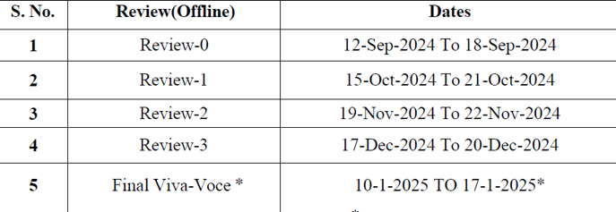
Timeline of Project

Slide 21
Outcomes /Results Obtained
Code Overview :
The code seems to be implementing a bidirectional accent translation system. It uses libraries such as:
speech_recognition for speech-to-text conversion.
gTTS (Google Text-to-Speech) for text-to-speech conversion.
pygame for audio playback.
googletrans for translating text between languages.
pycaw for managing audio utilities like microphone input status.

Slide 22
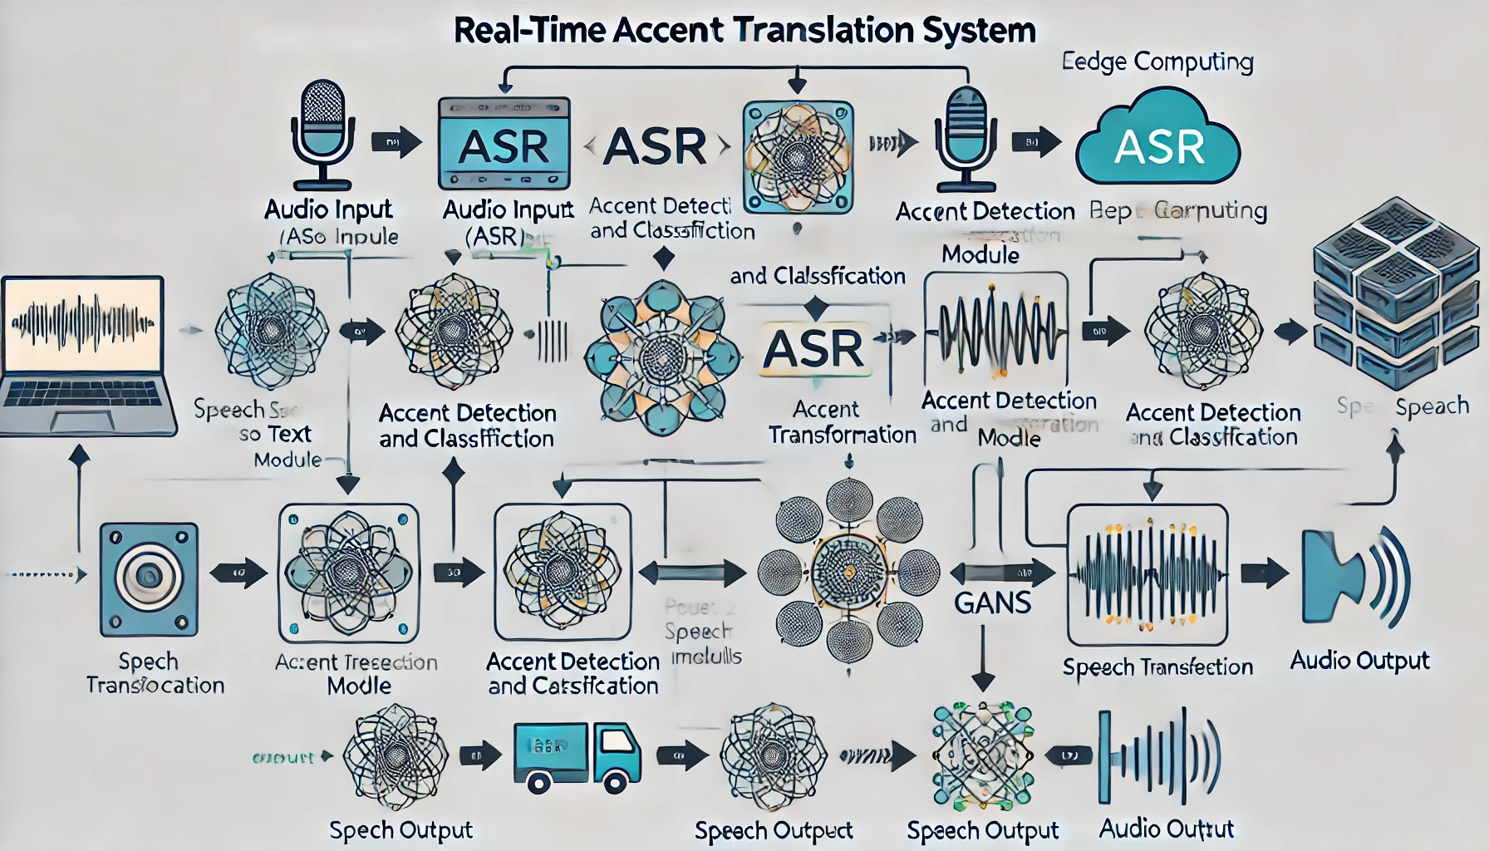

Slide 23
Functions are defined for:
Checking if the microphone is muted.
Converting text to speech and playing the output audio.
Execution Output :
The script has been run using the command %runfile, and the following results are demonstrated:
Initialization messages from pygame indicating that the library was able to load.
Input and output audio devices information:
The input device is set as "Microsoft Sound Mapper - Input."

Slide 24
VB-Cable, a virtual audio device, is found as output device at index 1.
The program asks the user to choose their input and output languages for translation:
Input Language for User 1: The choices available are US English, British English, Indian English, Hindi, Telugu, and Kannada.
Output Language for User 2 (Friend): Similar choices appear.
Implication and Conclusion: The application is configured such that input and output languages for speech translation and playback are dynamically selected in real-time. Once a user has selected choices, the application probably records the speech, translates it, and then plays the audio after translation.

Slide 25
Conclusion
The project on “Real-Time Accent Translation” showcases a novel way of filling communication gaps by making the spoken content translate in real-time between different languages and accents. The system, by incorporating cutting-edge technologies such as **speech recognition**, **natural language processing (NLP)**, **machine translation**, and **text-to-speech synthesis**, offers a user-friendly solution for breaking language barriers in diverse social and professional scenarios.
The program was able to:
1. Record speech input and process using the most reliable speech recognition systems.
2. Translate text between languages or accents using strong APIs such as **Google Translate**.

Slide 26
3. The translated text is then transformed into speech with natural-sounding audio to make it an interactive and effective communication process.
This project has tremendous practical applications in:
- **Global business communication**, when people from different linguistic groups collaborate.
- **Education and training**, when knowledge has to be imparted to groups of different linguistic groups.

Slide 27
- **Healthcare and public services**, with real-time translation for urgent interactions.
The system also lays a foundation for future improvements, such as reducing processing latency, integrating support for more accents and languages, and using advanced AI models like **transformer-based language models (e.g., GPT)** to improve accuracy and context understanding.

Slide 28
References
"Accent Conversion using Pre-trained Model and Synthesized Data from Voice Conversion" by Tuan Nam Nguyen et al. (2022).” This paper discusses accent conversion techniques that modify pronunciation patterns and prosody while preserving the speaker's voice quality and linguistic content.
"Non-autoregressive Real-time Accent Conversion Model with Voice Cloning" by Vladimir Nechaev and Sergey Kosyakov (2024)”. This study presents a model for real-time accent conversion with voice cloning capabilities, suitable for multi-user communication scenarios.

Slide 29
"Accent Conversion with Articulatory Representations" by Yashish M. Siriwardena et al. (2024). This research introduces the use of articulatory speech representations to enhance accent conversion effectiveness.
"A Survey of Voice Translation Methodologies". This paper surveys recent advances in speech engineering, focusing on recognition, translation, and synthesis in voice-to-voice translation devices.

Slide 30
Publication Details

Slide 31
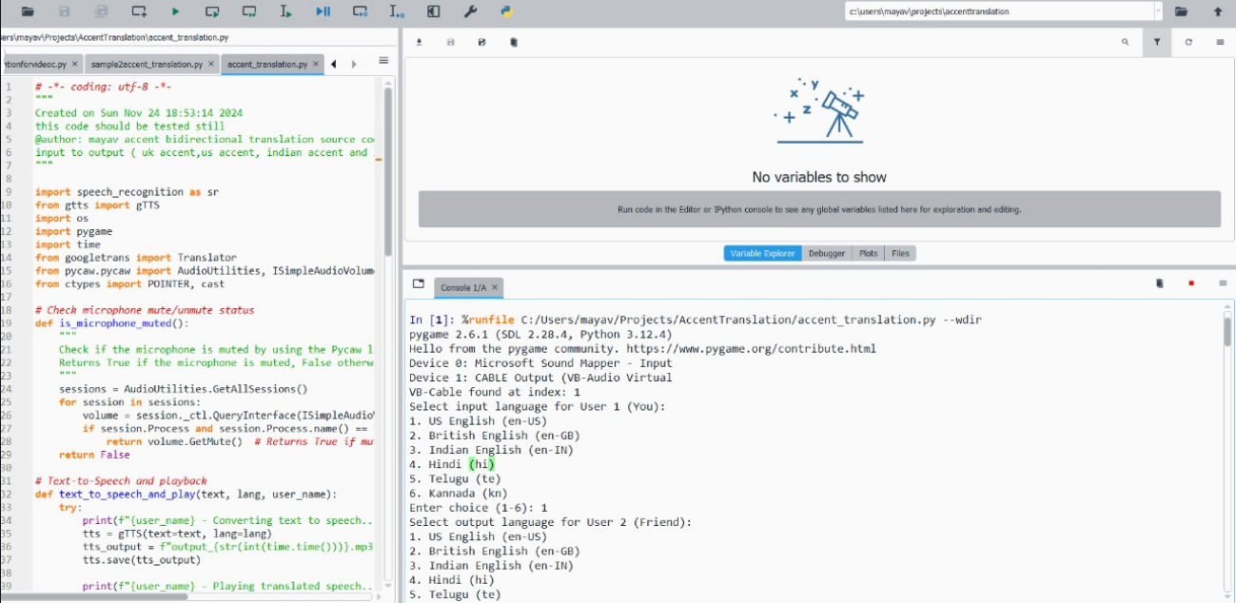
Screenshots

Slide 32
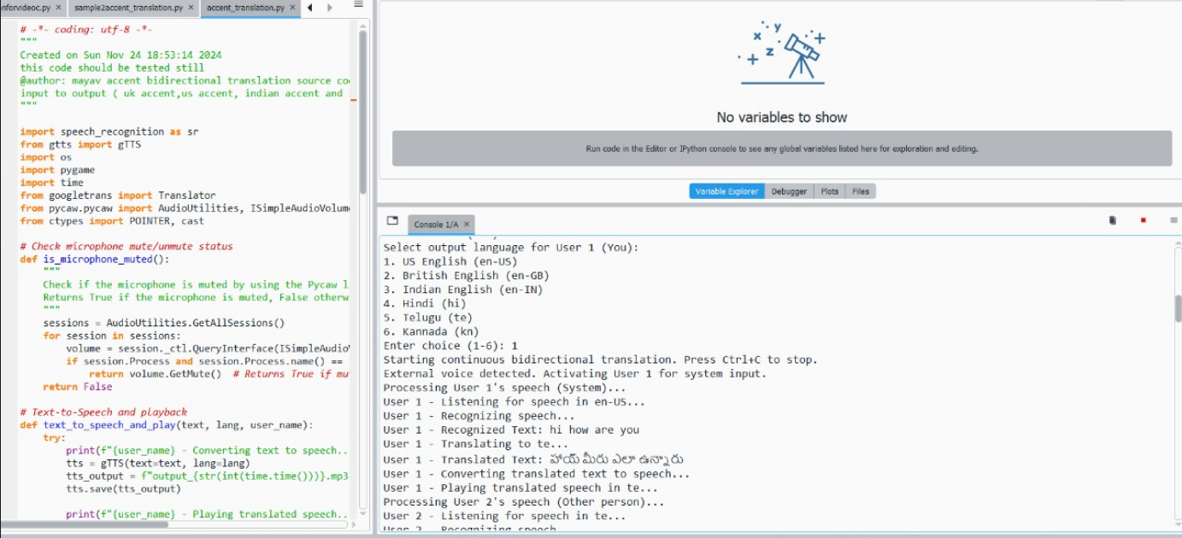

Slide 33
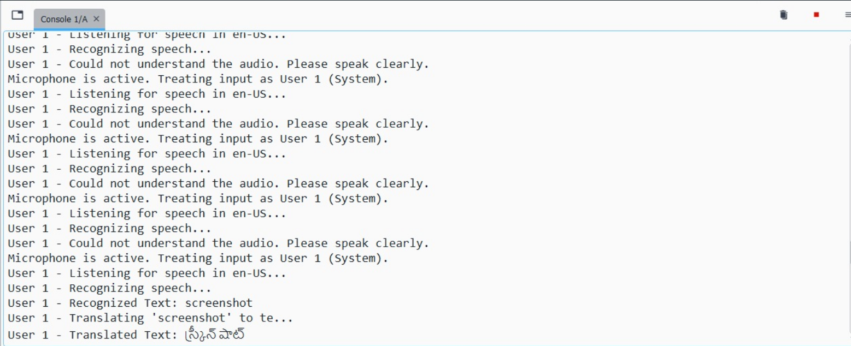

Slide 34
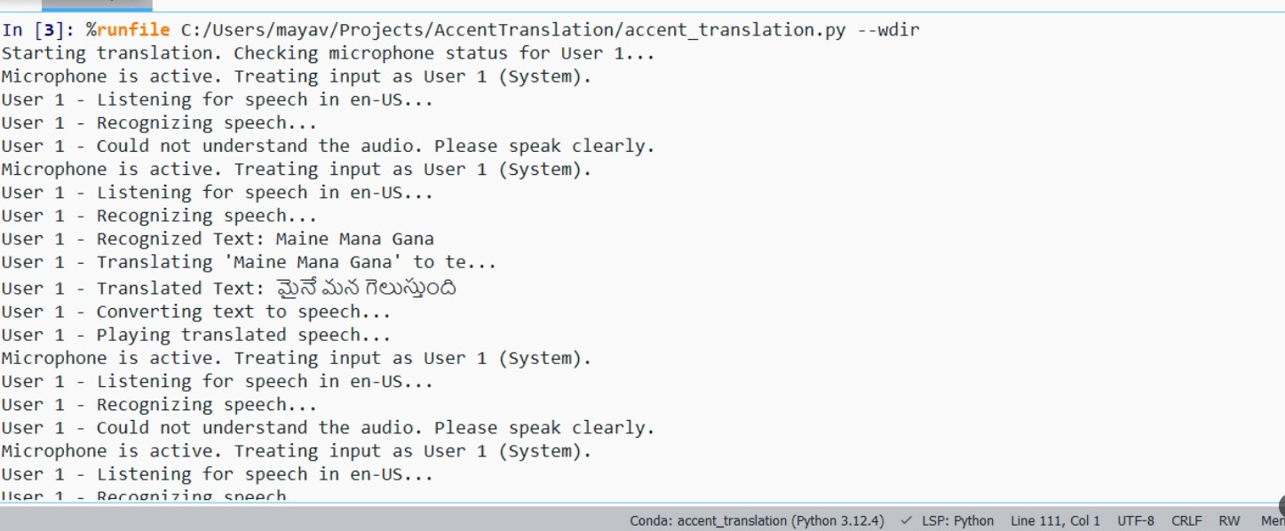

Slide 35
Github Link
https://github.com/capstonecse43/Capstone-project

Slide 36


